Slide 1
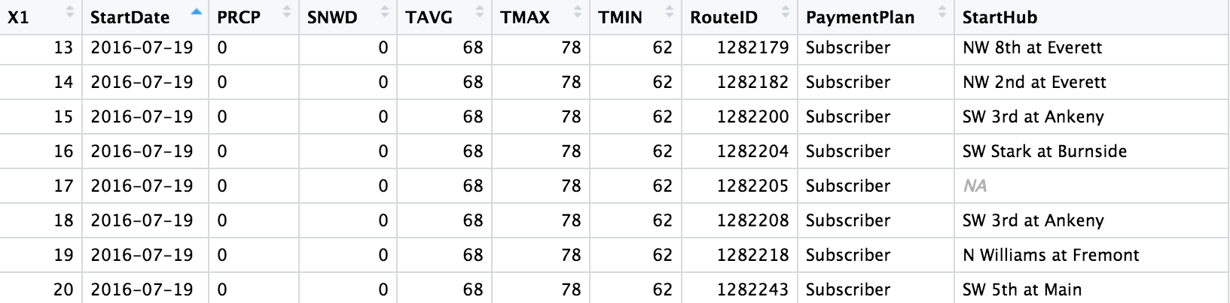


Adding rainfall and temperature to the existing data
…
…

Slide 4
Predicting Where Bikes Travel

Slide 5
Predicting Changes in Station Use

